Slide 1




PROJECT TITLE
1
Into the Pokéverse

Slide 2
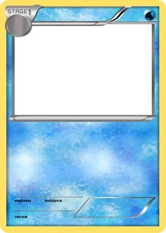
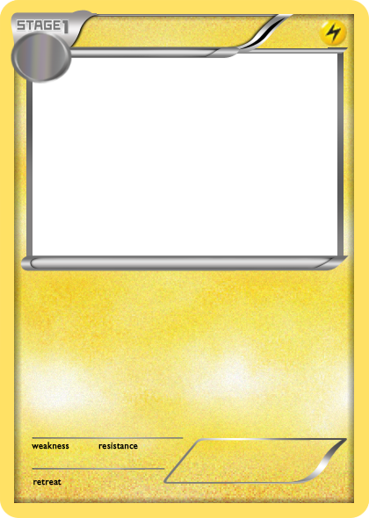
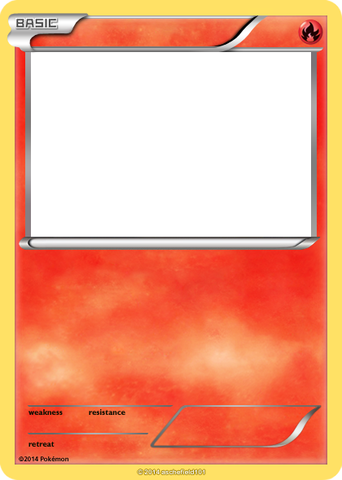
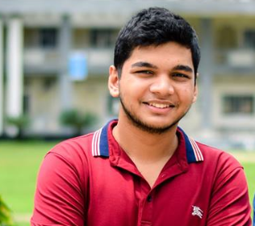

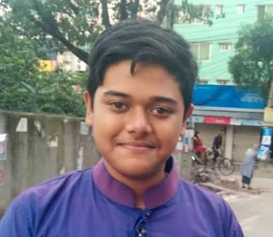
SUBMITTED BY:
2
Ridwan
Sartaj
Rifat
Ridwan Mahbub ID- 180041230
Syed MD. Sartaj Ekram ID- 180041204
Syed Rifat Raiyan ID- 180041205

Slide 3
PROJECT MOTIVATION
3
This is a passion-project for us, as the cartoon Pokémon was a core part of our childhood.
Collecting and trading Pokémon cards was a popular hobby back in our childhood.
Playing Pokémon games in Nintendo Gameboy was our favorite pastime.
Nostalgia for the franchise is the main driving force behind this project.

Slide 4
PROJECT DESCRIPTION
Key Features:
The source code of the entire game will be written in the C programming language.
The player’s decision-making and actions in-game will effect the game’s outcome.
The background music will be the 8-bit audio of the vintage Nintendo Gameboy’s Pokémon games.
The Pokémon arts incorporated in the game are assemblies of ASCII characters intended to resemble pixelated images.
The game will feature the map of a city where the plot of the game takes place.
The game will have a 3 vs. 3 layout as a battle format.
3

Slide 5
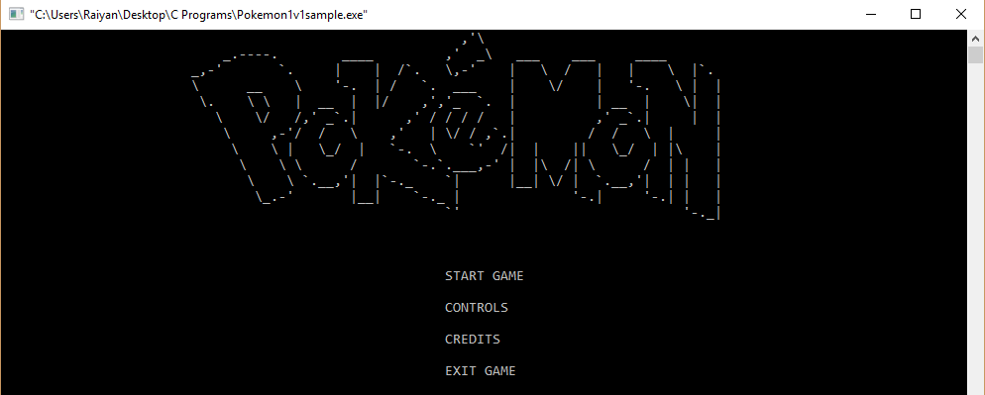
PROJECT FUNCTIONALITIES
4
Game Interface: Upon running the executable file of the game the player will see a Menu Interface displaying options such as, “Start”, “Controls”, “Credits”, “Exit”.

Slide 6
PROJECT FUNCTIONALITIES
5
Maps: The player will have the liberty to move around the map of a city and visit different locations. The principal locations are: Gym – For battling other Pokémon trainers. Pokémon Center – For healing injured Pokémons after a battle. Shop - For purchasing items to heal or improve damage and defense. Exit - For exiting the map.

Slide 7



PROJECT FUNCTIONALITIES
6
Gameplay Dynamics: 1) Choosing the Pokémons: After starting the game, the player will form a roster by choosing 3 Pokémons from a pool of multiple ones and the CPU will then proceed to choose 3 Pokémons.
CPU
Player

Slide 8
PROJECT FUNCTIONALITIES
7
2) Combat: The combat will be a turn-based system where each player will perform their move in subsequent turns. Every Pokémon has a set of specific skills which deal damage to the opponent Pokémon and thus decrease their Health Points (HP) by a specified number.

Slide 9

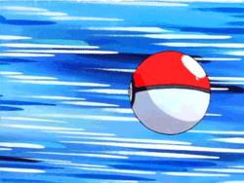
PROJECT FUNCTIONALITIES
8
3) Switching between Pokémons: The player will have the option to switch between Pokémons if they feel it’s necessary in the middle of the fight.
If HP low
Switch Pokémon
Resume Fight

Slide 10



PROJECT FUNCTIONALITIES
9
4) Using utility items: The player may choose to use healing potions which regenerate the Pokémon's HP. There will also be items which will increase the offense or defense.
Super Potion HP+=70
Potion HP+=30
Healing Potions
Dire Hit Critical Hit++
X Attack Damage++
Damage Items
Defensive Items
X Defense Damage Received--
Tough Candy XL Damage Received--

Slide 11
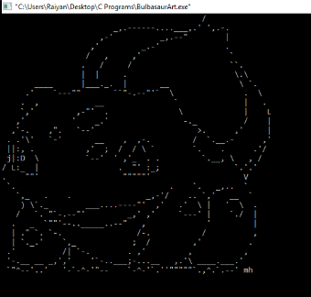

PROJECT FUNCTIONALITIES
10
5) Image Display: Images of the Pokémons will be depicted with ASCII character art and will be implemented in the program by using FILE pointers.

Slide 12
PROJECT REQUIREMENTS
11
Source Code written and edited in Code::Blocks IDE.
Audio files collected from soundcloud.com in .wav format.
Vector arts collected from vecteezy.com.
ASCII arts collected from asciiartarchive.eu.

Slide 13
PROJECT TIMELINE:
12
15.08.2019 - A simple version of the game.
30.08.2019 - Integration of features like map, healing items and more playable Pokémons. 15.09.2019 - Adding a suitable plot for the game.
31.09.2019 - A beta version of the game which will be subjected to further testing and improvement. 05.10.2019 - Debugging the game and adjusting and tweaking minor details.
15.10.2019- Final version of the game.

Slide 14
FUTURE ENDEAVOURS
13
Introducing pixel-arts and animations in the game.
Introducing a currency system in the game giving the player ability to purchase utility items.
Expanding the current city maps and including new ones.
Introducing a “Save Game” feature.

Slide 15
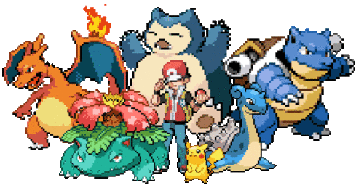
14
The End Thank You for Listening

